Slide 1




Texas A&M University - commerce
STRATEGIC ENROLLMENT PLAN
CAMPUS TOWN HALL

Slide 2
OVERVIEW
WHERE WE’RE AT TODAY
The timeline below outlines where we’ve come since initiating strategic enrollment planning efforts in October. Today, we will be sharing outcomes of this work and actionable next steps for enhancing enrollment and student success at TAMUC.
Project Kickoff
SEP Development
University Town Hall kicking off Strategic Enrollment Planning initiative
Established Strategic Priorities to inform a roadmap of action items and initiatives and refined with Steering Committee
Undergraduate & Graduate Current State Assessment
SEP Socialization & Implementation
Share TAMUC’s Strategic Enrollment Plan with the campus community to launch implementation of immediate priority action items
Qualitative & quantitative analysis of enrollment and retention outcomes to inform TAMUC’s vision for strategic enrollment management

Slide 3
FIRST-TIME FRESHMEN
OUTCOMES OVERVIEW – ENROLLMENT FUNNEL
Although TAMUC has seen positive funnel performance over the last ten years, since Fall 2017 applications have declined by 40% resulting in a spike of admitted students (+35 ppts.) to maintain incoming enrollments.
As the competitive landscape continues to heighten market pressures, TAMUC must make considerable shifts to rebuild its incoming enrollment pool.
Source: Institutionally Provided Data

Slide 4
FIRST-TIME FRESHMEN
OUTCOMES OVERVIEW – PEER ENROLLMENT
While TAMUC’s undergraduate enrollment stayed relatively constant between Fall 2016 and Fall 2020, its local public peers saw significant growth annually – UNT (+4%), UT-Dallas (+9%), and UT-Arlington (+6%).
Although TAMUC is experiencing small growth in enrollment, a strategic recruitment plan will help the institution right-size and remain competitive amongst its peers with higher enrollment growth.
Source: IPEDS
1 The decline in the 2020 incoming class is presumably due to the impact of the COVID-19 pandemic.
2. Idaho State University omitted due to lack of information in IPEDS

Slide 5
FIRST-TIME FRESHMEN
OUTCOMES OVERVIEW – PEER RETENTION
The incoming first-time freshmen Fall 2020 cohort for TAMUC’s peers retained at a rate of 76% - nineteen percentage points higher than TAMUC’s fall retention rate for that same year.
Fall 2020 Peer Retention Average = 76%
All of TAMUC’s peers have increased first-year retention since Fall 2016.
Source: IPEDS and data provided by institution
1 The decline in the 2020 incoming class is presumably due to the impact of the COVID-19 pandemic.

Slide 6
MASTER’S / SPECIALIST
OVERALL ENROLLMENT FUNNEL- MASTER’S / SPECIALIST
TAMUC’s overall enrollment funnel has seen a contraction in applications, completed applications, admitted students and enrolled students since 2012-2013.
The contraction among all areas of the enrollment funnel supports the need to employ a dedicated enrollment strategy.
1. Institutionally provided data.
2. *AY 2021-22 only includes incoming Fall students

Slide 7
MASTER’S / SPECIALIST
COMPLETION LEADERS- PEER INSTITUTIONS
Among TAMUC’s peers, since 2012, UT Arlington and UT Dallas have been completions leaders and have grown at 5.49% and 5.89% on average annually.
UT Dallas competes heavily in the non distance space, while UT Arlington competes heavily in the distance space. It is important for TAMUC to identify what space they would like to compete in.
Data pulled from Emsi. Emsi is a comprehensive database that combines labor market, job posting, and education data sources (www.economicmodeling.com).
CAGR is compounded annual growth rate.
Notes:
What is this slide trying to say?
Among TAMUC’s peers, since 2012, UT Arlington and UT Dallas have been completions leaders and have grown at 5.49% and 5.89% on average annually
UT Arlington has lead completions among all peers since 2012 AND they are also the leader among this institution set for Distance program completions. 57% of it’s completions come from Distance.
UT Dallas has also been a leader in completion among its peers since 2012 and they are also a leader among this institution set for Non-Distance completions. 86% of it’s completions come from Non-Distance.
TAMUC needs to pick a path and compete!!

Slide 8
STUDENT FOCUS GROUPS
THEMES & OBSERVATIONS – FIRST-TIME FRESHMEN
FTF students had positive feedback on their first semester then felt the quick dissolve of the honeymoon phase in the second term. Students’ primary concerns were around campus/community life and support services.
Students are approaching Commerce to apply, not being recruited
“I feel like the first semester at Commerce is really supportive but then, after that, you’re just a bank to the institution”
Students felt unsupported after their first year at Commerce
Class size and affordability are the biggest value propositions for students
“I’m a senior and I’ve had at least 8 different advisors. It’s like a revolving door”
Students feel a breakdown of communication between faculty and advising teams
Free application and quick admission response was highly appreciated
“Commerce made it a lot easier for me to make the decision”
Inconsistency of faculty quality and engagement
In-person orientation gets students excited to come to TAMUC
“It feels like the onus is on students to entertain and program campus. That’s too much stress”
Discontentment with Commerce (nothing to do, feeling unsafe, town/gown strain)

Slide 9
STUDENT FOCUS GROUPS
THEMES & OBSERVATIONS – TRANSFERS
Transfer students’ transition to Commerce is bumpy. With a lack of personalized support services, streamlined credit evaluation, and perceived low quality of education, transfers are unimpressed with the ROI of their education.
Value proposition for transfer students include proximity to home and affordability
“They don't process Pell Grant appeals until 10 days before the semester starts, so I had to take loans out anyways.”
Financial aid processes and timelines leave students with unfavorable options.
Most notable presence of Commerce in community was through local educators
Desire for online classes with the campus co-curricular experience
"I don't make $1,000 a week; I can't give [Commerce] $400 every two weeks.”
Students perceive the quality of their education to be low due to tedious work and lack of student engagement by faculty
“This whole semester, I have learned zero.”
“I wouldn't say classes are hard necessarily, but it's tedious.”
Transfers felt uninformed about support services available (LLC’s, orientation options, etc.)
The credit transfer process was cumbersome and left a lot of students guessing and needing to self-advocate
“When I came here, my schedule was already made. My advisor handed me a schedule and said, ‘here's your classes.’”
Transfers desire a specific advising process intuitive to their specific journey rather than a regurgitated script.

Slide 10
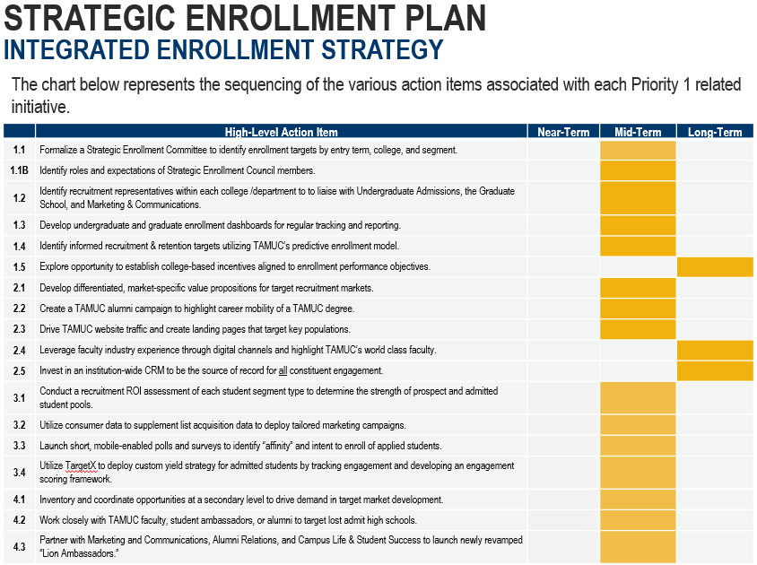
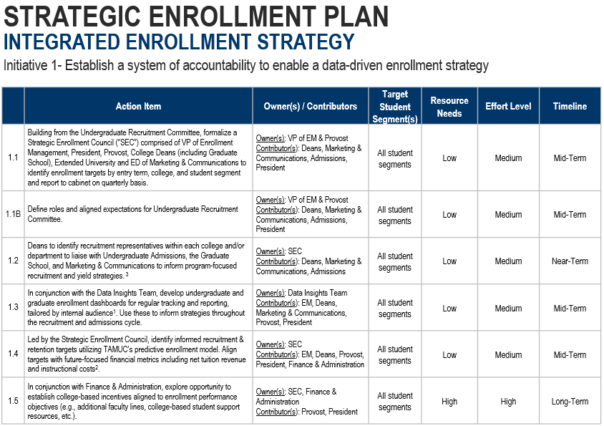
STRATEGIC ENROLLMENT PLAN
A DETAILED LOOK AT THE FIVE-YEAR PLAN
While the full Strategic Enrollment Plan will be shared on TAMUC’s SEP webpage, the below snapshots highlight the detailed components of the Plan that will drive implementation efforts over the next five years.
Snapshot 2: Detailed action items in support of SEP initiative
Snapshot 1: High-level overview of action items and implementation timeline

Slide 11
STRATEGIC ENROLLMENT PLAN
IMMEDIATE ACTION ITEMS FOR IMPLEMENTATION
To initiate implementation efforts of TAMUC’s SEP, the Steering Committee worked together to identify high priority initiatives. Those initiatives below will be led by cross-functional action teams of TAMUC volunteers.
01
Customer Service Model
Institute a University wide “high touch experience” policy that includes solution-oriented practices – including institutionalizing a standard of returning email and phone communication within 24 hours.
02
Retention Expectations
Define expectations of faculty and staff in supporting student retention-related activities including clarifying advising loads, student touchpoints, data collection & reporting processes (EAB Navigate), and end-of-term evaluation policies.
03
First-Year Degree Pathways
Evaluate degree pathways and recommend first-year course plans across each College to alleviate risky combinations and increase likelihood of first year success for incoming students.

Slide 12
STRATEGIC ENROLLMENT PLAN
STRUCTURE FOR MANAGING IMPLEMENTATION
The implementation of the SEP will be guided by the Steering Committee (SC). In partnership with the SC, cross-functional Action Teams (AC) will be responsible for executing initiatives aligned to each strategic priority.
Implementation Structure
SEP Steering Committee
Project Management (PM) Support
Action Team 1
Action Team 2
Action Team 3
Initiative Research, Analysis, Execution, Decision Development
We need your help in building the Action Teams and supporting the execution of identified action items to enhance how we enroll and support students at TAMUC.

Slide 13
STRATEGIC ENROLLMENT PLAN
IMPACT OF SUCCESS VS. COST OF NOT CHANGING
Outlined below are the positive impacts that TAMUC will experience if the plan’s changes are successfully implemented, and the costs of not moving toward change, to further support the case for action.
WHAT ARE THE POSITIVE IMPACTS THAT WILL BE EXPERIENCED IF THE PLAN IS SUCCESSFUL?
Aligned execution of agreed-upon priorities for enrollment.
A common direction and institutional sense of accomplishment.
A reduction in the uncertainty of enrollment, enabling a more deliberate use of limited resources – monetary and human.
Improved student outcomes and overall student experience across all populations.
WHAT ARE THE COSTS OR CONSEQUENCES OF NOT CHANGING?
Other institutions evolve more rapidly, further increasing competition in an already competitive environment.
TAMUC will have more difficulty keeping pace with prospective student market’s demands.
TAMUC’s brand may be negatively impacted by declining student outcomes.
TAMUC’s enrollment trends could continue to stagnate or decline, necessitating a plan from a higher-pressure position.
TAMUC would be unable to pivot in an ever-changing enrollment environment due to recent global events.

Slide 14
STRATEGIC ENROLLMENT PLAN
MAINTAINING MOMENTUM AND SECURING EARLY WINS
In an effort to maintain the momentum that was established during the SEP planning process and secure early implementation wins, Huron recommends that TAMUC focus on the five next steps below.
Immediate Next Steps
1 | Identify Action Team membership to begin implementation efforts of the three high-priority action items. Action Teams to be established by May 13th
2 | Host Kickoff Meetings with each Action Team to discuss roles and responsibilities and next steps in driving execution of each action item Kickoff Meetings to be held by May 20th
3 | Identify subtasks/next steps for high-priority action items and create project plan with identified owners for each task Initial project plan created by end of May

Slide 15
STRATEGIC ENROLLMENT PLAN
STEERING COMMITTEE MEMBERS
Strategic Enrollment Planning (SEP) Steering Committee
Nechell Bonds, Vice President of Enrollment Management (Co-Chair) | Michael Knight, Assistant Professor (Theatre)
Dr. Ricky Dobbs, Associate Provost for Academic Affairs (Co-Chair) | Jayson Douglas, Director (Intercultural Engagement & Leadership)
Mario Hayek, Dean (College of Business) | Jeremy Anderson, Assistant Director (Institutional Research)
Jennifer Schroeder, Dean (Graduate School) | Cece Gassner, Vice President (Economic Development)
Jeremy Gamez, CIO (Information Technology) | Dr. Julia Ballenger, Professor, Faculty Senate President (Educational Leadership)
Michael Johnson, Executive Director (Marketing and Communications)

Slide 16
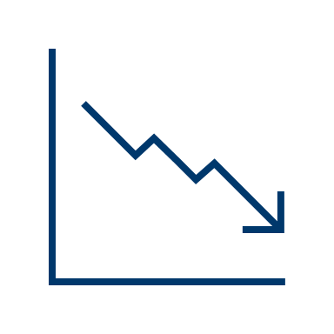


OVERVIEW
WHY DOES TAMUC NEED A SEP?
TAMUC engaged Huron Consulting Group to develop a Strategic Enrollment Plan to proactively address the current enrollment and student success trends identified below.
Flexible Degree Options
Students are demanding flexibility. While TAMUC offers online modalities & non-traditional degree options – students still seek the campus experience and faculty engagement.
Revenue
Due to Texas’s funding model, TAMUC has implemented a revenue-enhancing strategy by increasing fees to exceed overall tuition, which is a significant area of complaint for students across populations.
Transfer Enrollment
Transfer enrollment for TAMUC has been in decline since Fall 2019 – further exacerbating future enrollment challenges as community college pipelines decrease.
Increased Diversity
Although historically underrepresented minority students are growing regionally, TAMUC is not serving these students well – attrition rates are highest for Black and LatinX students.
Regional Competition
As the Dallas metroplex continues to grow, TAMUC is losing considerable market share to University of North Texas and UT-Arlington.
The Lone-Star
State
TAMUC is focused on enhancing its presence in the Dallas metro region, but student outcomes associated with Dallas-residents are significantly lower and continue to drop.

Slide 17
STRATEGIC ENROLLMENT PLAN
FRAMEWORK: ELEMENTS OF THE PLAN
The Strategic Enrollment Plan is driven by the positioning statement and strategic priorities, which articulates TAMUC’s vision for enhancing enrollment and student success over the next five years. From there, the SEP is composed of a set of actionable initiatives and activities to achieve the goals set forth.
Positioning Statement
A unified statement highlighting key attributes TAMUC aspires to achieve through the execution of the Strategic Enrollment Plan.
Strategic Priorities
TAMUC’s SEP has three overarching priorities that will guide all activities and action items with explicit goals and metrics.
Initiatives to Pursue
Each strategic priority then includes a set of initiatives to pursue supported by detailed action items for execution.
Goals & Metrics
High-level goals have been to defined in alignment with each priority, but TAMUC will continue to evaluate and refine these metrics to accomplish the goals set out in the Plan.

Slide 18
STRATEGIC ENROLLMENT PLAN
VISION FOR ENROLLMENT & STUDENT SUCCESS
The positioning statement and three priorities below – derived from discussion and evaluation of the graduate and undergraduate opportunities – serve as the foundation for the key initiatives that will drive TAMUC’s plan.
SEP POSITIONING STATEMENT
A&M-Commerce transforms students’ lives and promotes social mobility through quality experiences driven by engaged faculty and staff, innovative teaching and learning, and market-relevant programs.
INTEGRATED ENROLLMENT STRATEGY
Develop a data-informed, campus-wide enrollment strategy with measurable evidence of impact to create sustainable growth across all programs.
CULTURE OF STUDENT SUCCESS
Establish a culture of accountability in supporting student success at TAMUC by defining roles and responsibilities for campus stakeholders to increase student progression.
DYNAMIC ACADEMIC EXPERIENCE
Deliver a dynamic academic experience that offers innovative degree options – through versatile modality and program types – and is aligned to market demands and student needs.

Slide 19
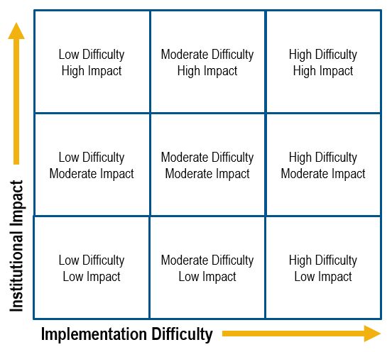
STRATEGIC ENROLLMENT PLAN
IMMEDIATE ACTION ITEMS FOR IMPLEMENTATION
To initiate implementation efforts of TAMUC’s SEP, Steering Committee members participated in an exercise to determine initiatives within the Plan that should be prioritized for near-term implementation efforts.
Approach to Prioritization:
Reviewed initiatives from the SEP
Individually categorized top 2-3 using the grid below
Identified immediate action items to be implemented by impact vs. difficulty
High Priority Action Items
01
Customer Service Model
Institute a University wide “high touch experience” policy that includes solution-oriented practices.
02
Retention Expectations
Define expectations of faculty & staff in supporting student retention-related activities.
03
First-Year Degree Pathways
Evaluate degree pathways and recommend first-year course plans across each College.

