Slide 1
Avoiding pitfalls with sections 6 (faculty) and 8 (student achievement)
What a reviewer will look for…
Elizabeth Vogt
AVP Accreditation
University of North Texas

Slide 2
6.1 – Full-time Faculty
Definition of faculty roles/type
Detailed expectations (teaching, service, research) for each type
How is # of faculty linked to budget?
Detailed description of how you decide the # of faculty is adequate to support the mission and goals
Student-faculty ratio
Faculty workload by college
Percentage of courses or SCH taught by FT and PT faculty at the institutional level (Face-to-face or internet)
Explain what courses are included and/or not included
Notes:
Tenure track- instructors- lecturers- faculty of practice
Policy
We did not include private lessons, independent study, theses and dissertation hours as there are not regular contact hours

Slide 3
6.2.a- Faculty Qualifications
Only include instructor of record
If the degree and/or level do not match the SACSCOC guidelines, explain in detail
If the degree is not in the teaching discipline, explain in detail
Include your justification “process”
Notes:
We farmed much of the detail work to ass deans, who could filter down to chairs. Do not plan on taking time off this summer. Have them reviewing fall now if possible!

Slide 4
6.2.b – Faculty by Program
Look at the list of programs provided in the institutional summary. Every program should be represented in this section.
Define what you are including in the program analysis
Upper division only?
Course type included (lecture, lab, practicum?)
Report and discuss faculty overloads
Discuss how you know courses taught online or at an off-site are comparable to those offered at the main campus

Slide 5
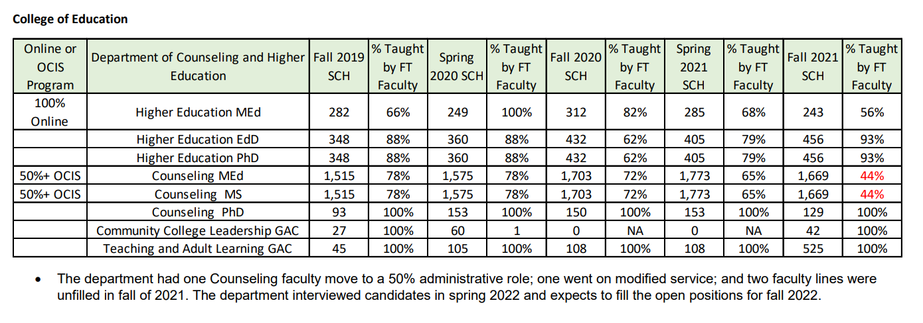
6.2.b cont’d
Notes:
This was a huge pain- I used to be in IR, so I did all of the data analysis… Down to picking courses and working with faculty. Probably about 200 hours of work invested just on the tables

Slide 6
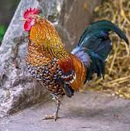
6.2.c – Program coordination
Include a roster

Slide 7
6.3 – Faculty appointment and evaluation
Policies and criteria must be published
Depending on faculty role (FT/PT, Tenured/Tenure track/non-TT), evaluations may have different criteria
Course evaluations alone are not sufficient!
Notes:
We are currently changing as we don’t have pt process. 6.4 academic freedom and 6.5 faculty development are pretty straight forward.

Slide 8
8.1 Student Achievement
Define terms and defend your measures
Include the goal, threshold, and actual data for each indicator of achievement
Notes:
You cannot over-explain here. Pick a threshold and defend it.

Slide 9
8.1 cont’d
You must include your Key Student Completion Indicator as identified for SACSCOC
Also provide a pdf of your student achievement webpage
Notes:
Do not forget this! Most common reason for non-compliance here

Slide 10
8.2.a-c: Outcomes and improvement
Describe and defend your process- show that it is continuous.
We included examples of feedback provided to IE plan owners going back to 2009 (Overkill)
Thoroughly describe integration of online and off-sites in the process
Disaggregate where possible; explain where not possible
Plans that should have but did not provide disaggregated data or sound reasoning lost points on the review rubric
If you use a sample, make sure it is representative
Reviewers may (and often do) ask for additional program reports
Notes:
We went overboard because we could… We used a sample because of our size. We described the total number of programs at each level for each college. We selected at least one at each level and one from every discipline- approximately 1/3 of our total number of programs

Slide 11
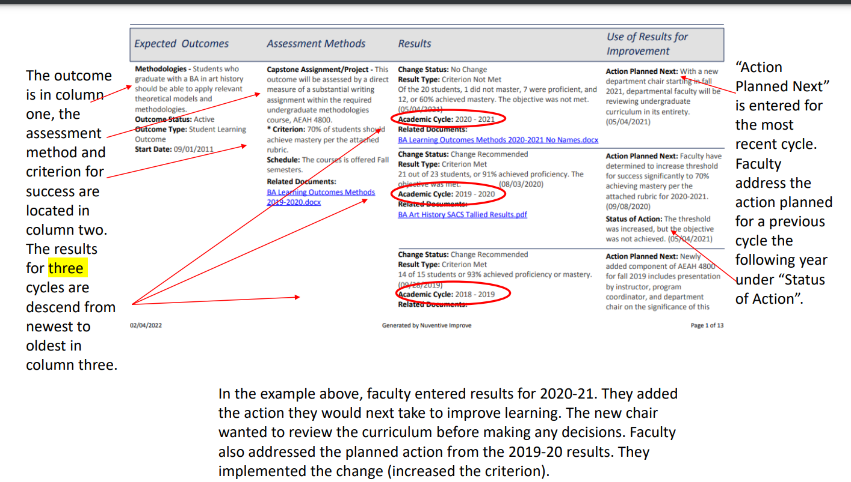
8.2 cont’d
Explain how to read your reports
Notes:
We do not all use the same terms. We actually highlighted this section and left it in bright yellow to ensure it was seen. A consultant did not see it the first time. They saw it the next and actually read what we were doing.

Slide 12
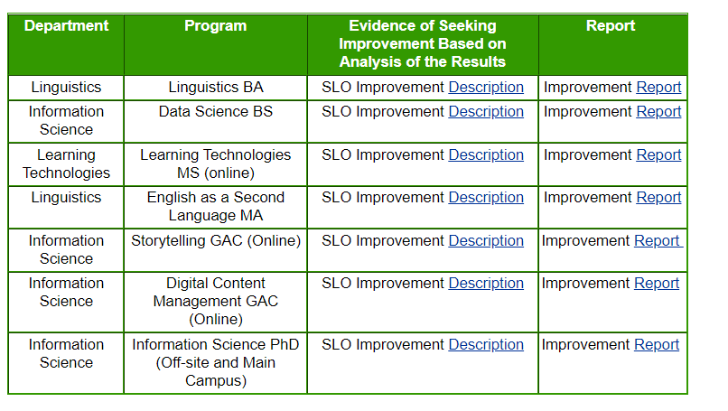
8.2 cont’d
DO NOT make a reviewer dig through reports to find an example!
Notes:
The reports can show history, but make it easy on your reviewers.

Slide 13
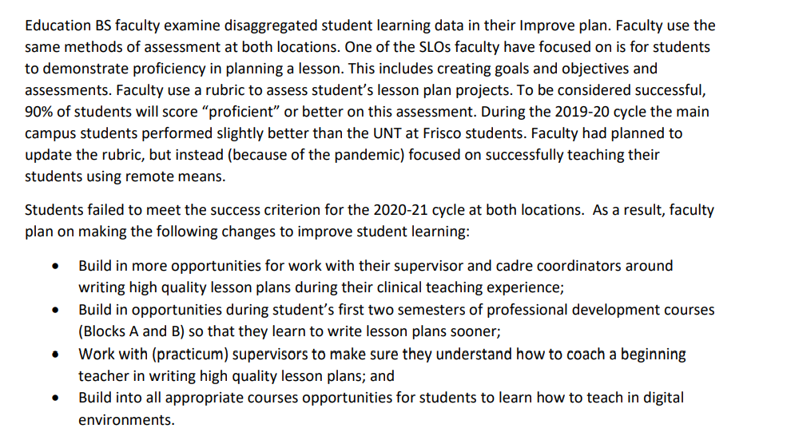
8.2 cont’d
Notes:
Take the time to write a summary of an improvement made for every included program.

Slide 14
Questions?
Elizabeth.Vogt@unt.edu

